Slide 1
Mobile Application Development
CEF440 – Internet Programming Mobile Programming
GROUP 4

Slide 2
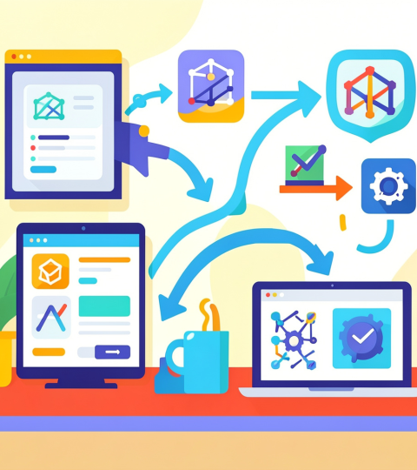
Introduction
Mobile applications are used daily for communication, banking, and entertainment.
Mobile apps shape daily life; the build choices determine performance, cost, and user delight.
Make strategic technology, architecture, and process decisions to deliver value faster and scale reliably.

Slide 3
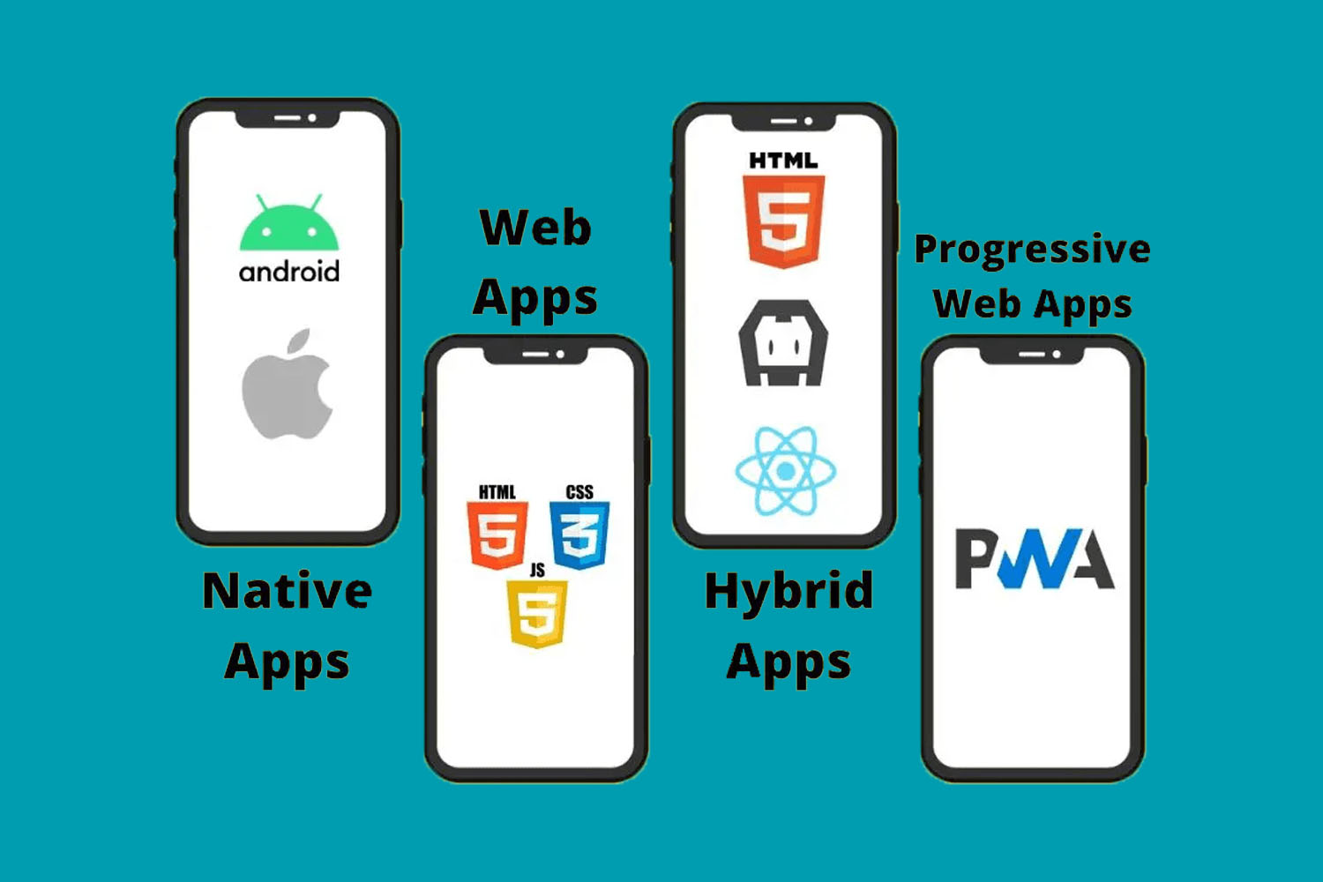
01
Types of Mobile Applications

Slide 4
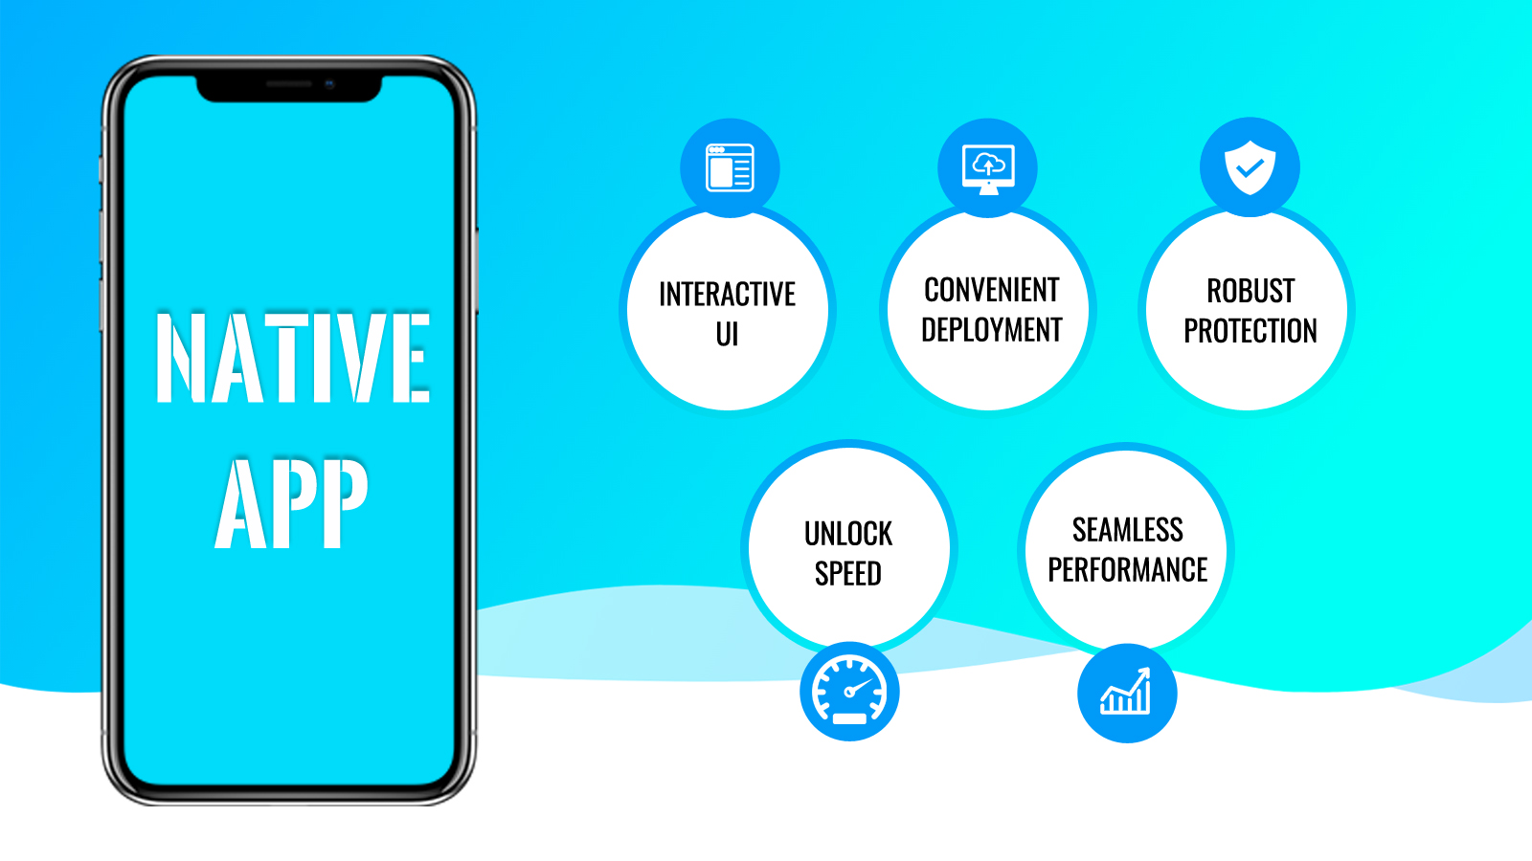
Native Apps
Native apps are built specifically for one platform like Android or iOS.
They provide the best performance and full access to device features.
Examples
- WhatsApp
- Google Maps
Advantages
- Very fast and responsive
- Better user experience

Slide 5
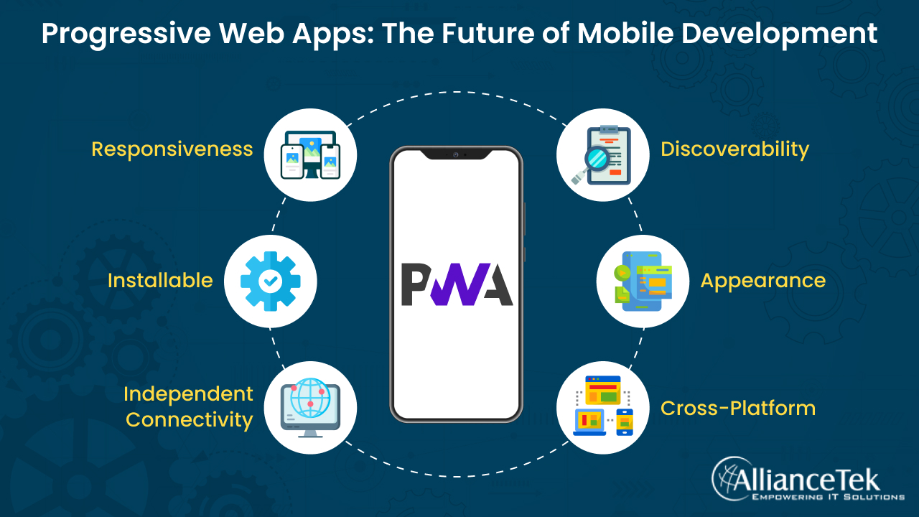
Progressive Web Apps
Web-based apps that behave like mobile apps for low cost and instant updates.
Ideal for broad reach, rapid delivery, and reduced maintenance overhead.
Examples Advantages
- Spotify - Low development cost
- Telegram - No app store installation needed

Slide 6
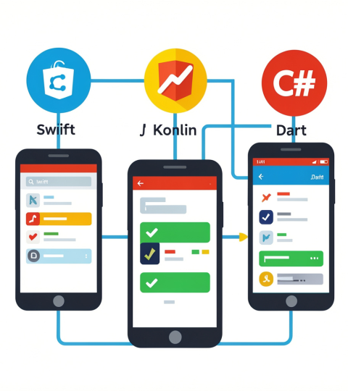
Hybrid Apps
Combine web and native for a balanced trade-off: faster multi-platform delivery with native distribution.
Best when time-to-market and budget are priorities.
Examples
- Instagram
- Gmail

Slide 7
Comparison of Type of mobile applications
Feature | Native | PWA | Hybrid
Performance | Excellent | Moderate | Good
Offline Support | Yes | Yes (limited) | Yes
App Store Distribution | Yes | No | Yes
Development Speed | Slow | Fast | Medium
Code Reusability | None | Full | High

Slide 8

Choosing the Right Approach
The choice depends on the project:
High performance → Native
Low budget → PWA
Balance → Hybrid

Slide 9
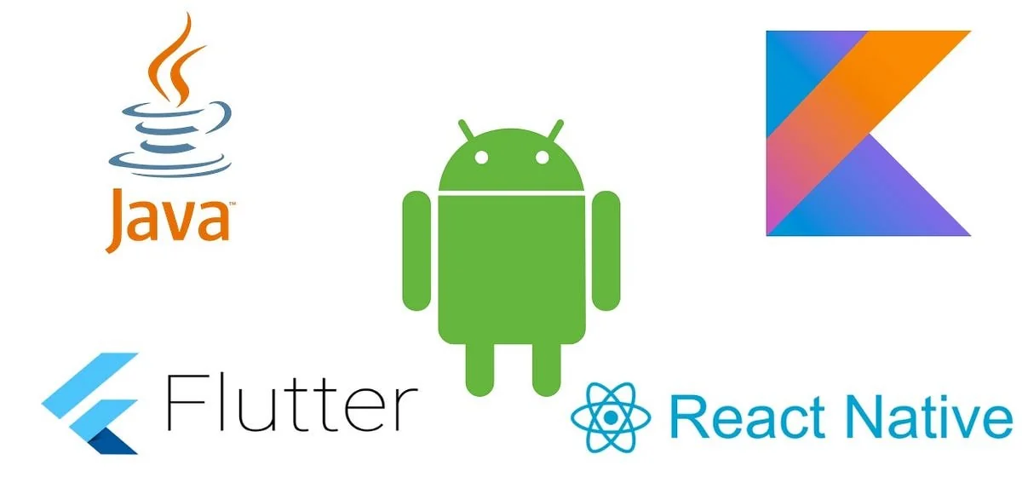
Mobile Programming Languages
Different languages are used in mobile development.
Examples:
Kotlin → Android
Swift → iOS
JavaScript → React Native
Dart → Flutter

Slide 10
Comparison Between Frameworks
Criteria | Flutter | React Native | .NET MAUI | Ionic | KMP
Performance | Excellent | Very Good | Good | Moderate | Excellent
Cost & Time | Medium | Medium | Med-High | Low | Medium
UX / UI | Consistent | Near-native | Native | Web-like | Fully native
Community | Large | Very large | Enterprise | Large | Growing
Platforms | All | Mobile | Mobile+Win | Mobile+Web | Mobile
Flutter offers consistent UI and high performance across platforms with Dart.
Great for teams aiming for pixel-perfect design and single codebase efficiency.

Slide 11

Why Languages Choice Matter
We choose the language that aligns with platform goals and team strengths.
Kotlin for Android, Swift for iOS, and C# for enterprise/.NET ecosystems. Right choice reduces bugs and speeds delivery.
Prioritize maintainability, performance, and existing team expertise when deciding.

Slide 12
Architectures & Design Patterns
Architectural patterns shape maintainability and testability.
MVC
MVP
MVVM
Clean Architecture
Presenter replaces Controller View is passive (no logic) Easier to unit test Popular in Android (pre-MVVM)
ViewModel with data binding Reactive UI updates Ideal for modern Android/iOS Used with LiveData, StateFlow
Layers: Domain → Data → UI Dependency rule (inward only) Highly testable and modular Scales for large teams
Model → View → Controller Classic separation of concerns Controller can become bloated Good for simple apps

Slide 13

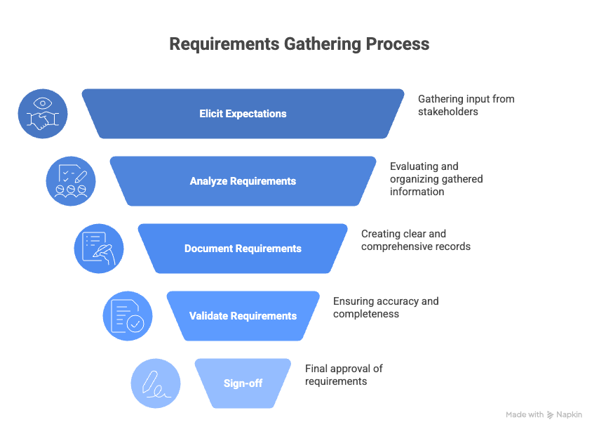
Requirements & Costs
Before coding, developers must understand what to build.
Skipping this may step leads to wasted time and wrong solutions.
Some Main steps:
Gathering information
Analyzing requirements
Documenting them
Validating with users
Example: A banking app must define login, security, and transactions clearly before development.

Slide 14
Functional Requirement
Non-Functional Requirement
The user must be able to log in with their email and password.
The app must send a push notification when a new message arrives.
Screen Sizes
Responsive layout testing
Battery Life
Performance/Responsiveness
Portability/Compatibility

Slide 15
Conclusions
1
2
3
No single best app type — it depends on budget, audience, and features
Each language exists for a reason, backed by real-world adoption
Flutter and React Native empower small teams to ship cross-platform
4
5
6
Architecture patterns separate maintainable from chaotic codebases
Requirement engineering grounds projects in reality
Cost estimation gives teams a shared language for scope decisions

Slide 16
Thank you!

